Slide 1
The road to taxonomy-specific RPS-BLAST
Marc Gwadz
Christiam Camacho
Jianli Dai
Hanguan Liu
Mingzhang Yang
Codeathon (10/16/2019—10/18/2019)

Slide 2
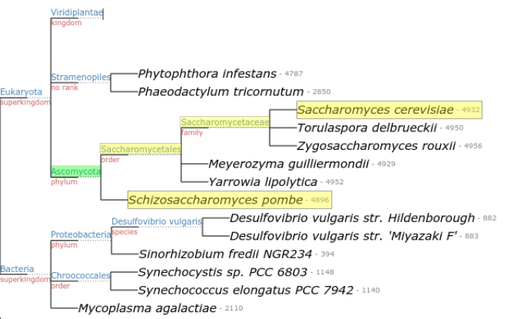
Goal
To assign taxonomy information to conserved protein domains
Use taxonomy information to limit an RPS-BLAST search

Slide 3
Workflow
PSSM Model
IPG | taxid | Taxonomy lineage
l1 | tl1 | tl1-1,tl1-2,tl1-3,…
l2 | tl2 | tl2-1,tl2-2,tl2-3,…
m | tm | tm-1,tm-2,tm-3,…
… | … | …
CDD
Taxonomy
Tree
Model
taxid
Conserved Domain Database
Decompose the model in its parts:
IPGs, their taxonomy IDs, and each of the taxonomy lineage for these

Slide 4
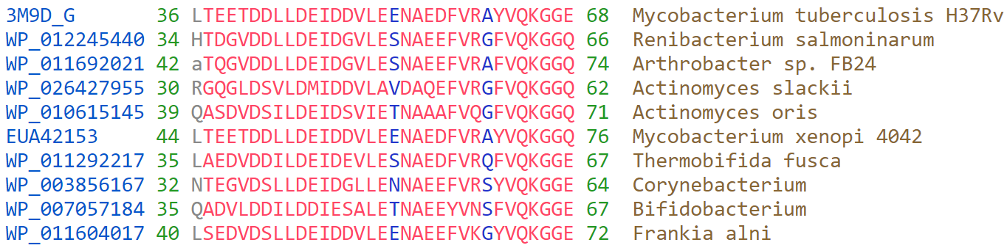
PSSM Model
PSSM-Id: 200311, pupylate_cterm

Slide 5
Table of TaxIds
PSSM-Id | PSSM accession | taxid | taxOrg | nIPG | nGi | taxLineage
200311 | TIGR03687 | 1883 | Streptomyces | 131 | 605 | 131567->2->1783272->201174->1760->85011->2062
200311 | TIGR03687 | 1883427 | Actinobacteria bacterium | 41 | 49 | 131567->2->1783272->201174->1760->52018->78537
200311 | TIGR03687 | 1762 | Mycobacteriaceae | 28 | 935 | 131567->2->1783272->201174->1760->85007
200311 | TIGR03687 | 2053607 | Candidatus Rokubacteria bacterium | 28 | 44 | 131567->2->2323->1783234->1752708
200311 | TIGR03687 | 1763 | Mycobacterium | 26 | 229 | 131567->2->1783272->201174->1760->85007->1762
200311 | TIGR03687 | 1773 | Mycobacterium tuberculosis | 24 | 40 | 131567->2->1783272->201174->1760->85007->1762->1763->77643
200311 | TIGR03687 | 1716 | Corynebacterium | 23 | 178 | 131567->2->1783272->201174->1760->85007->1653
. | . | . | . | . | . | .
. | . | . | . | . | . | .
. | . | . | . | . | . | .

Slide 6
Table of Tax. Lineages
PSSM-Id | PSSM accession | taxid | taxOrg | nIPG | nGi | taxLineage
200311 | TIGR03687 | 1883 | Streptomyces | 131 | 605 | 131567->2->1783272->201174->1760->85011->2062
200311 | TIGR03687 | 1883427 | Actinobacteria bacterium | 41 | 49 | 131567->2->1783272->201174->1760->52018->78537
200311 | TIGR03687 | 1762 | Mycobacteriaceae | 28 | 935 | 131567->2->1783272->201174->1760->85007
200311 | TIGR03687 | 2053607 | Candidatus Rokubacteria bacterium | 28 | 44 | 131567->2->2323->1783234->1752708
200311 | TIGR03687 | 1763 | Mycobacterium | 26 | 229 | 131567->2->1783272->201174->1760->85007->1762
200311 | TIGR03687 | 1773 | Mycobacterium tuberculosis | 24 | 40 | 131567->2->1783272->201174->1760->85007->1762->1763->77643
200311 | TIGR03687 | 1716 | Corynebacterium | 23 | 178 | 131567->2->1783272->201174->1760->85007->1653
. | . | . | . | . | . | .
. | . | . | . | . | . | .
. | . | . | . | . | . | .

Slide 7
Taxonomy Tree

Slide 8
Outline
Extract taxonomy IDs for each model
Extract each taxID’s lineage
Build a model specific subset of the taxonomy tree with relevant taxIDs
Assign a weight to each node
Find the lowest common ancestor that meets a threshold (e.g.: 95% of all taxIDs are under that node)

Slide 9
Dependencies:
Python
ete-ncbiquery: Fast and handy queries to the NCBI taxonomy database (http://etetoolkit.org/documentation/ete-ncbiquery/)
taxidlineage.dmp extracted from new_taxdump.zip available in NCBI Taxonomy ftp site ftp://ftp.ncbi.nlm.nih.gov/pub/taxonomy/new_taxdump/

Slide 10
Find the lowest common tax. node
Tax lineage-----------------------------------------------------------------------------------------------------→
taxid | root | ??? | ??? | ??? | ??? | ??? | ??? | ???
taxid1 | x | x | x | x | x | x | x
taxid2 | x | x | x | x | x
taxid3 | x | x | x | x | x | x
taxid4 | x | x | x | x
taxid5 | x | x | x | x

Slide 11
IPG-1
TaxID-1
IPG-2
Root
Domain-1
TaxID-2
IPG-3
IPG-4
TaxID-3
TaxID Domain-1
TaxID-1
TaxID-4
Domain-2
IPG-5
TaxID-4
.
.
.
.
.
.
.
.
.
TaxID-2
TaxID-3
Domain-l
IPG-n
TaxID-m

Slide 12
